Slide 1

Arab Academy for Science &Technology & Maritime Transport College of Artificial Intelligence
Data Science Department
DS413 Big Data Analytics
Project classification bank customers
Supervised By: Prof .Osama Badawy
Eng. Hady Yasser
By:
Karim Gaber 221003403

Slide 2
Introduction
Goal: Predict customer churn to identify at-risk customers and encourage the use of fixed banking transactions, promoting customer loyalty and increased engagement with banking services..
Business Problem: High churn rates lead to significant revenue loss. Analyzing withdrawal and deposit patterns is crucial due to the presence of wallets available in every store, helping improve customer loyalty.

Slide 3
Dataset Overview
Brief description of the dataset:
Size: 1.5Gb
Key Attributes: Customer Age, Gender, Income, Card Category, Total Transactions
Mention the data source and preprocessing.

Slide 4
Data Preparation&Engineering
Describe the preprocessing steps:
Handling missing values.
Encoding categorical variables.
Feature scaling and normalization.
Remove outliers.
Time based features

Slide 5
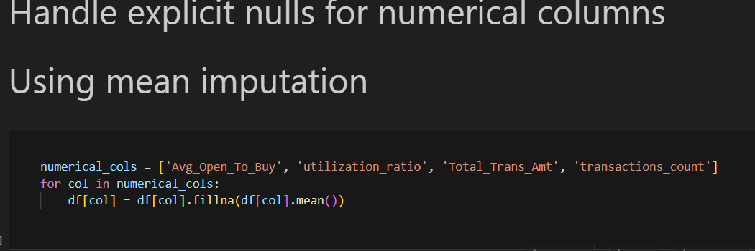

Slide 6


Slide 7
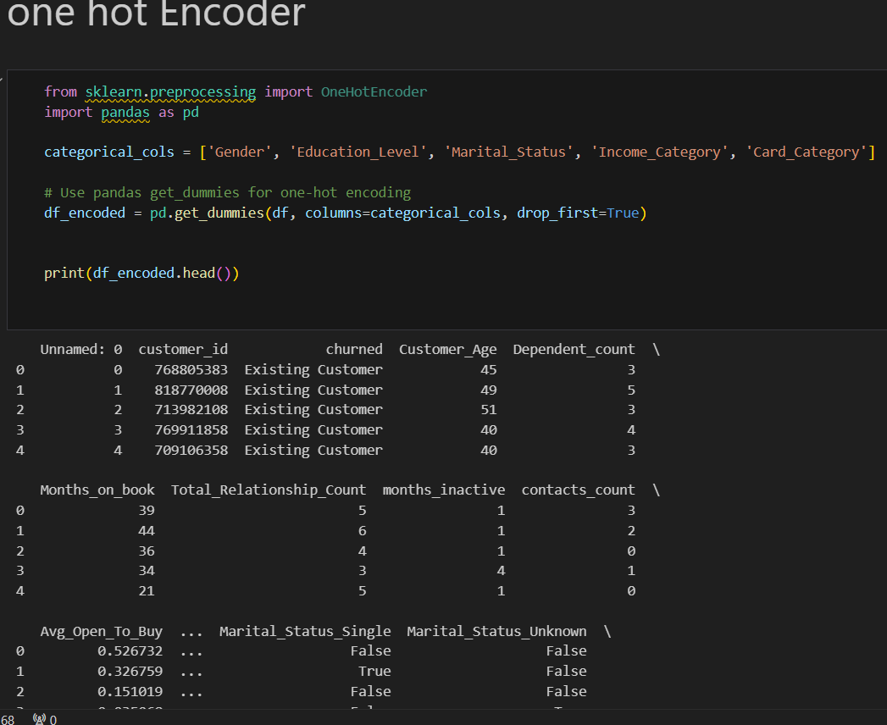

Slide 8
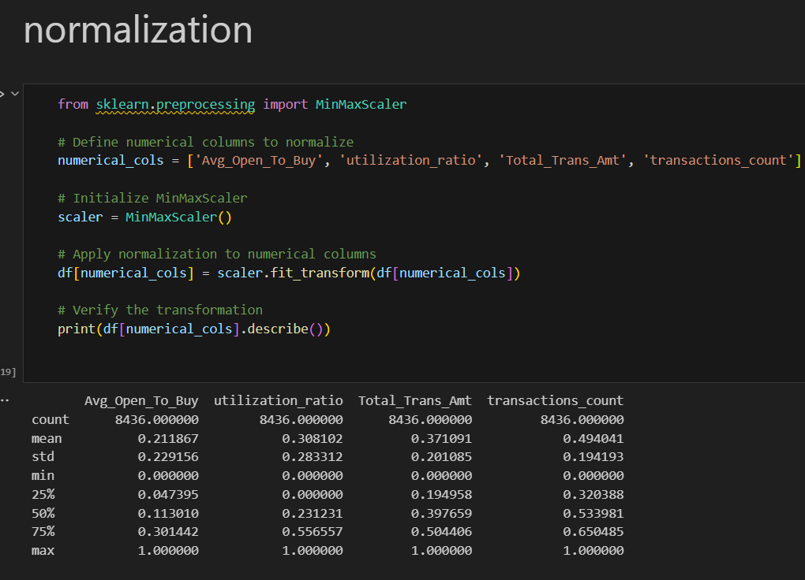

Slide 9
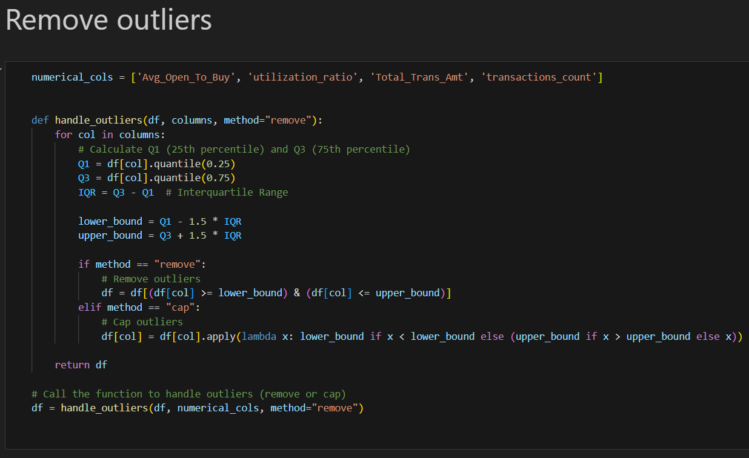

Slide 10
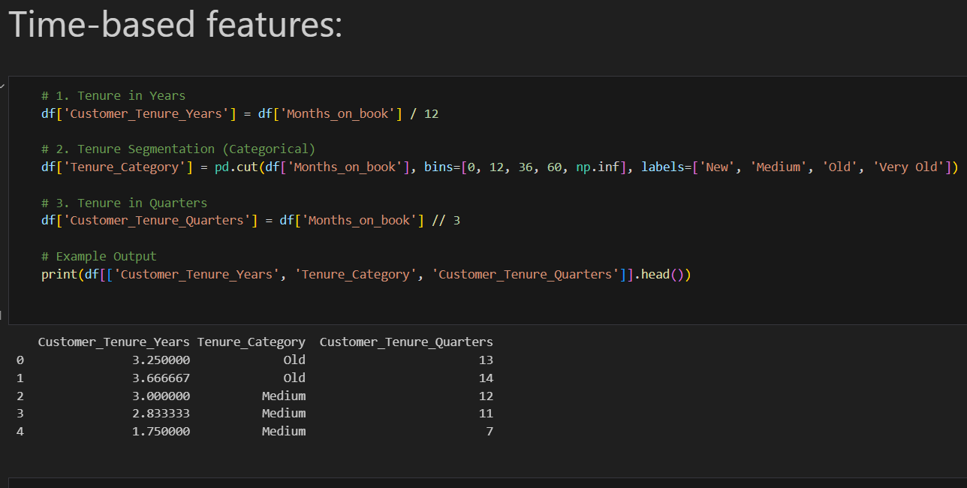

Slide 11
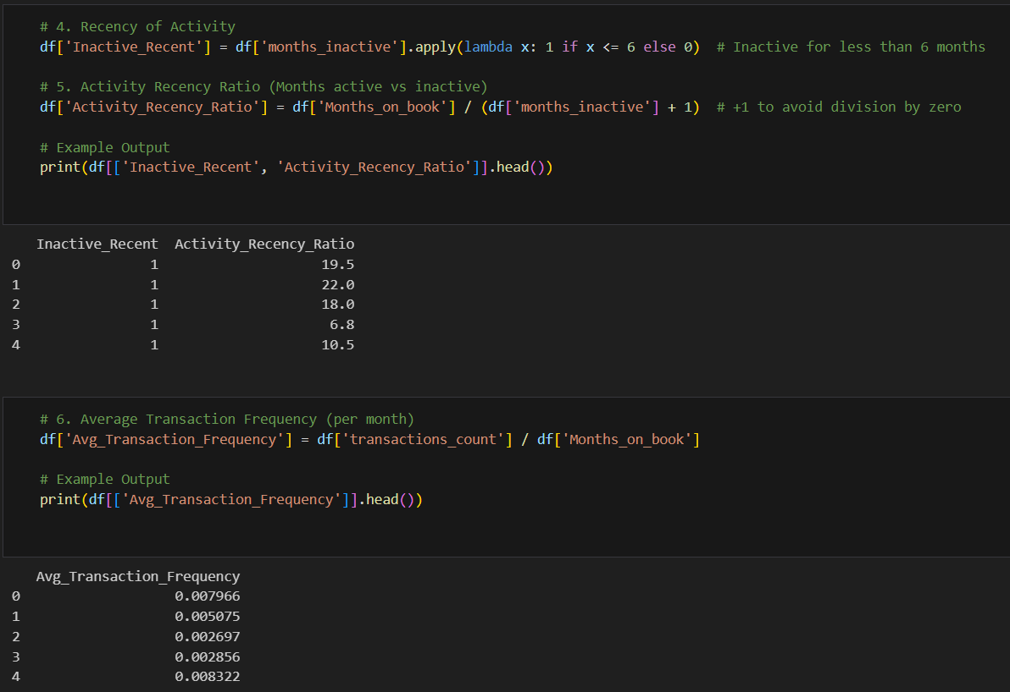

Slide 12
Data Partitioning for Spark
Training Data: 70-80% used for model training.
Validation Data: 10-15% used to tune model parameters.
Testing Data: 10-15% used to evaluate model performance.
Method: Use randomsplit() for partitioning datasets into these subsets in Spark.

Slide 13
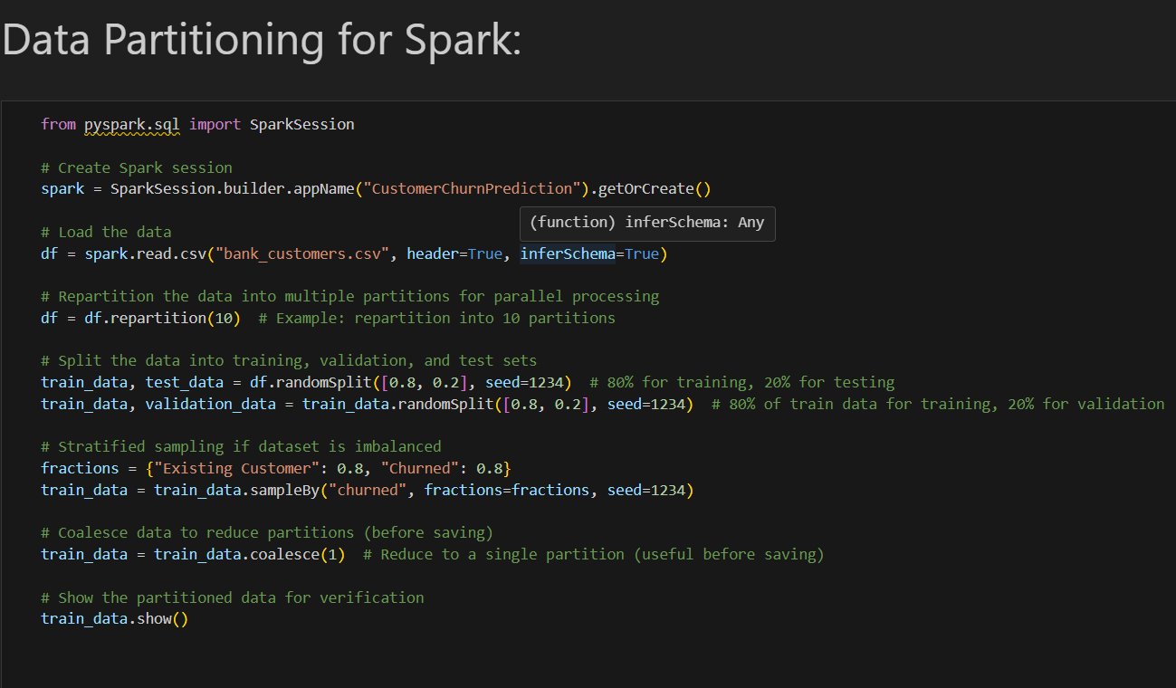

Slide 14
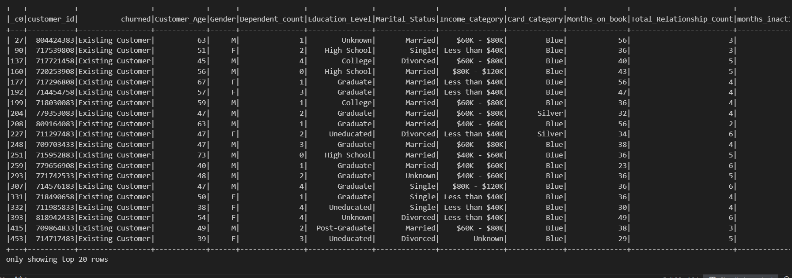

Slide 15
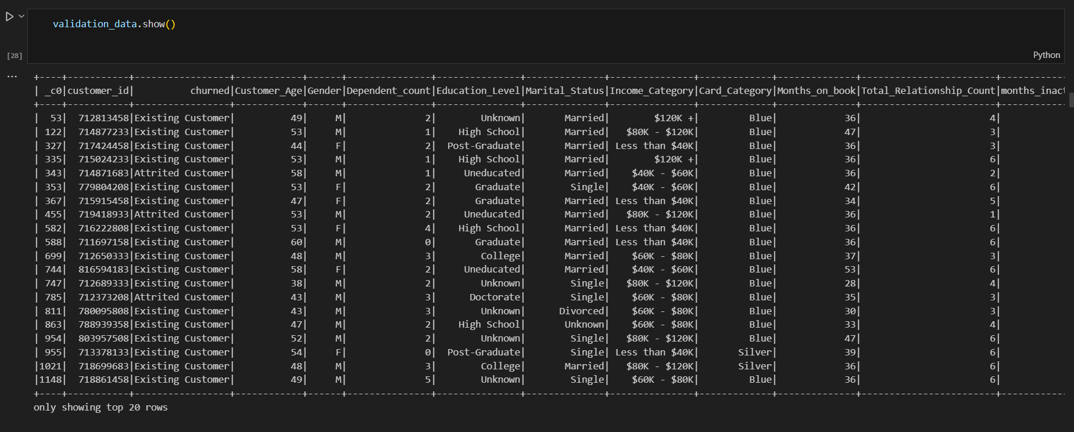

Slide 16
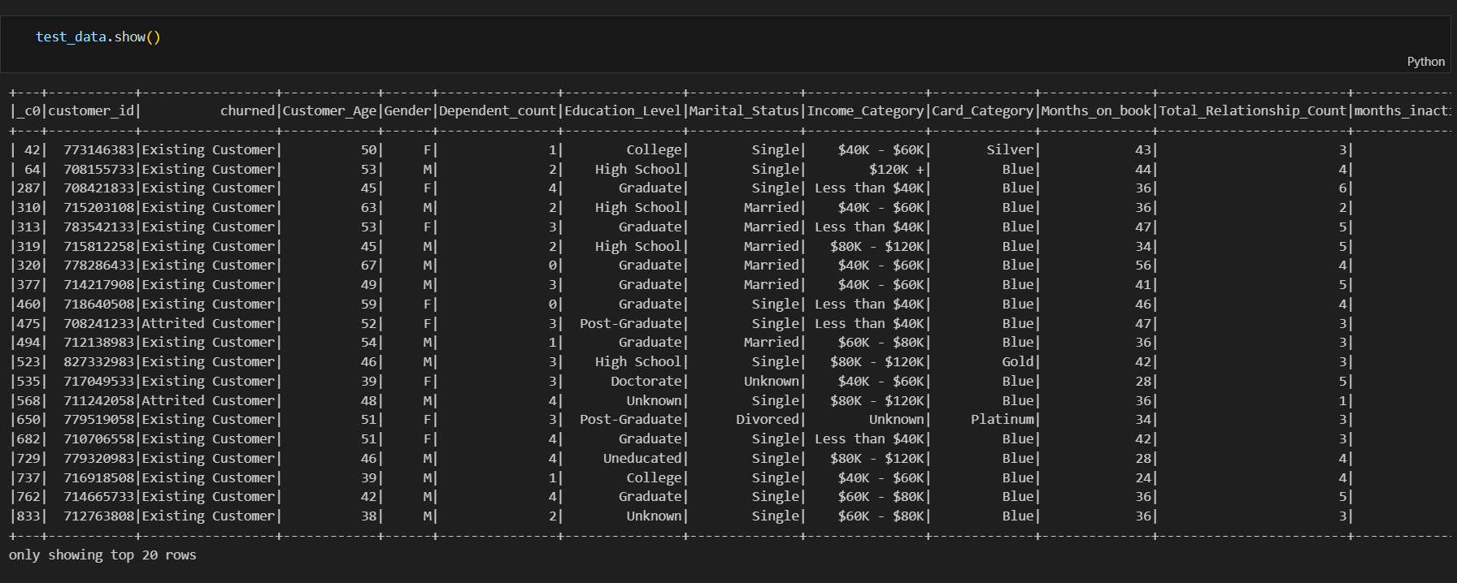

Slide 17
Model Selection
Models considered:
Logistic Regression
(accuracy ,recall,precision, f1-score confusion_matrix)
Decision Trees
Feature Importance after decision tree

Slide 18
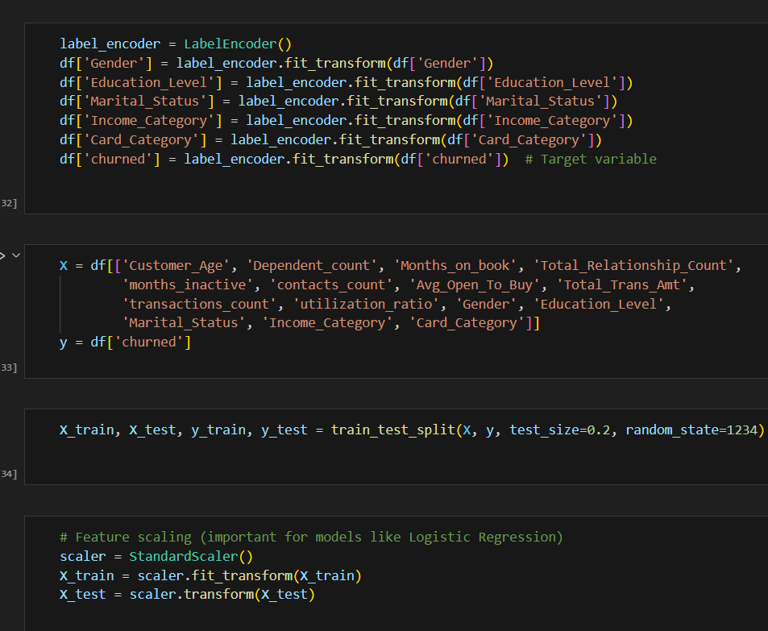

Slide 19
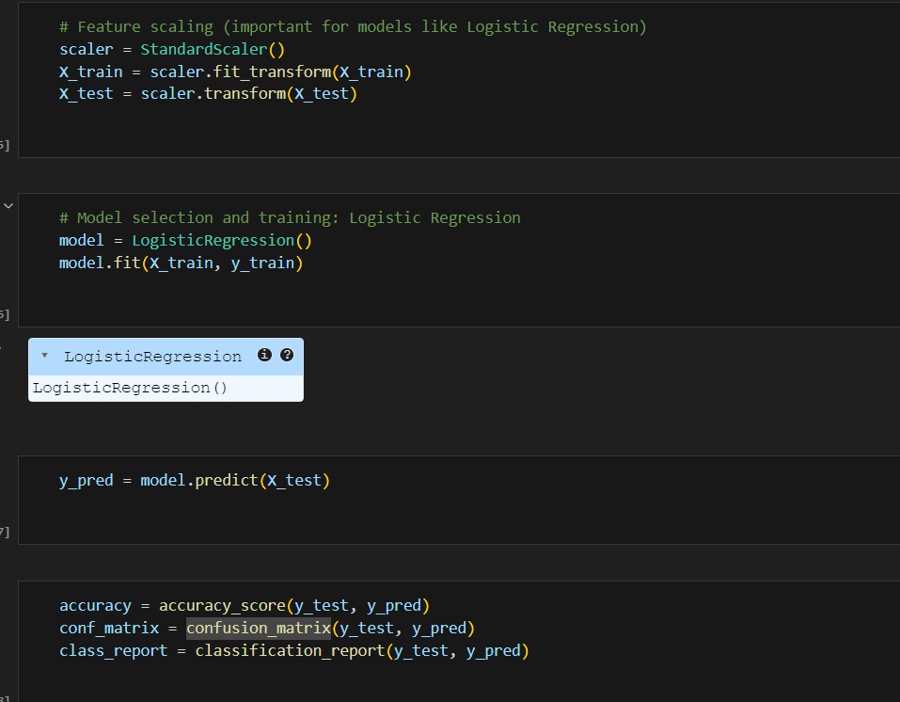

Slide 20
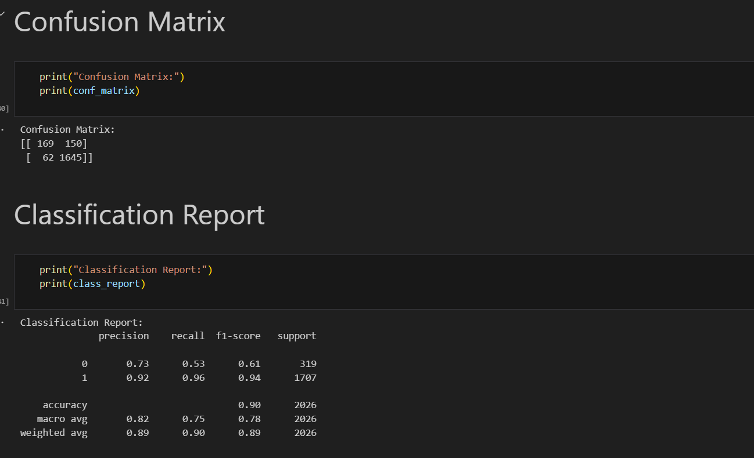

Slide 21
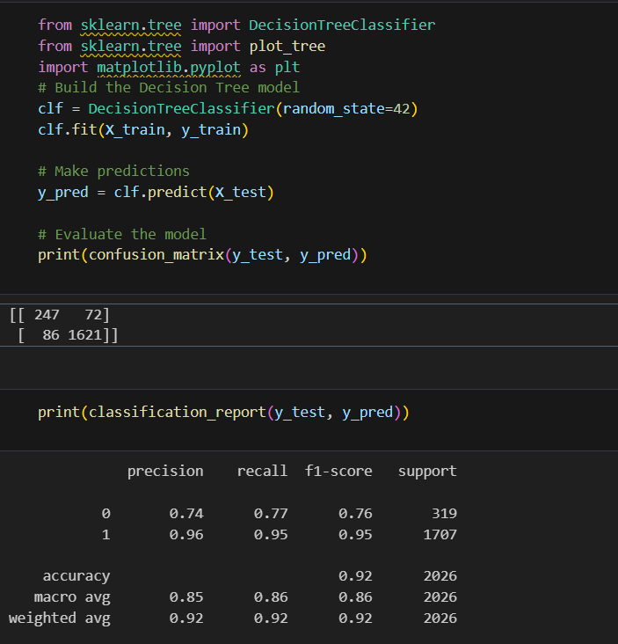

Slide 22
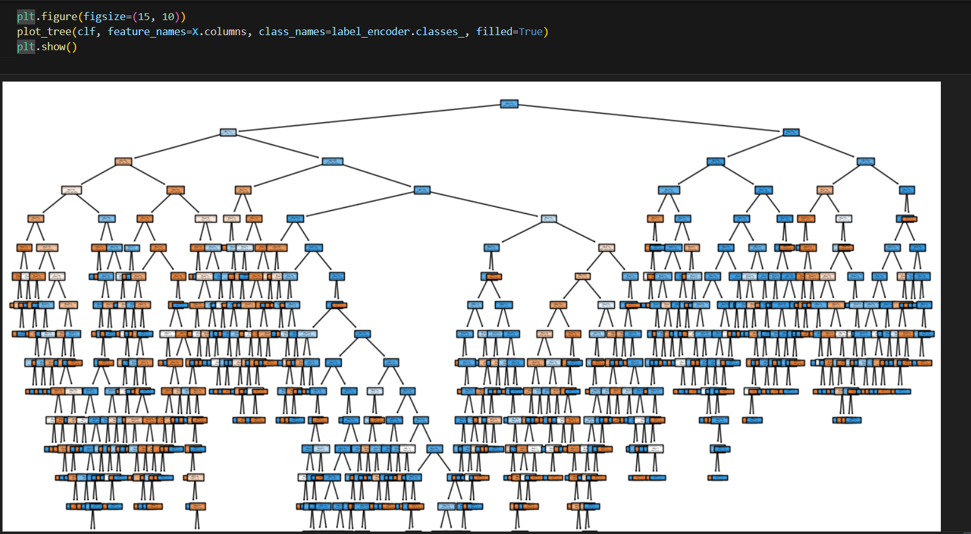

Slide 23
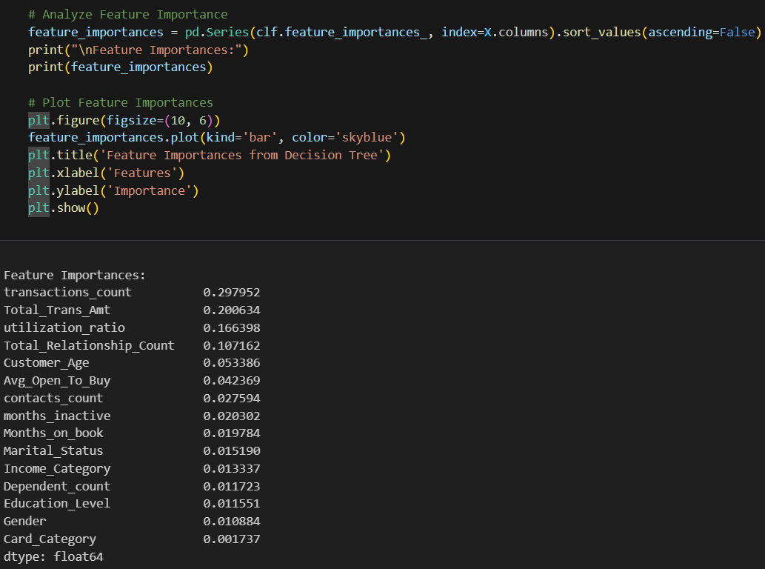

Slide 24
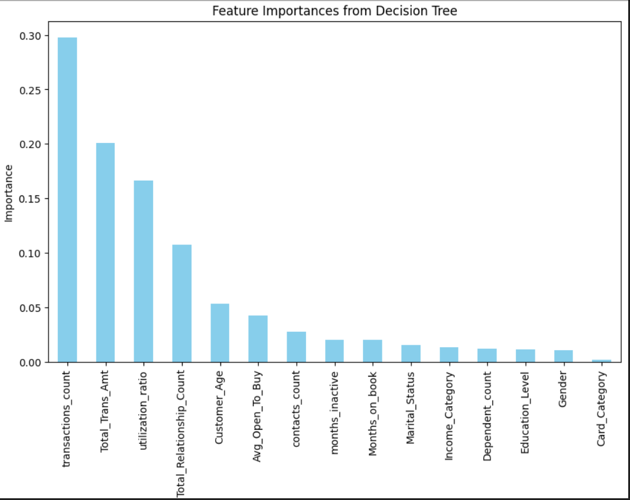

Slide 25
Model Evaluation using random forest
Metrics used:
Accuracy
Precision, Recall, and F1 Score
Include a comparison table of model performance.

Slide 26
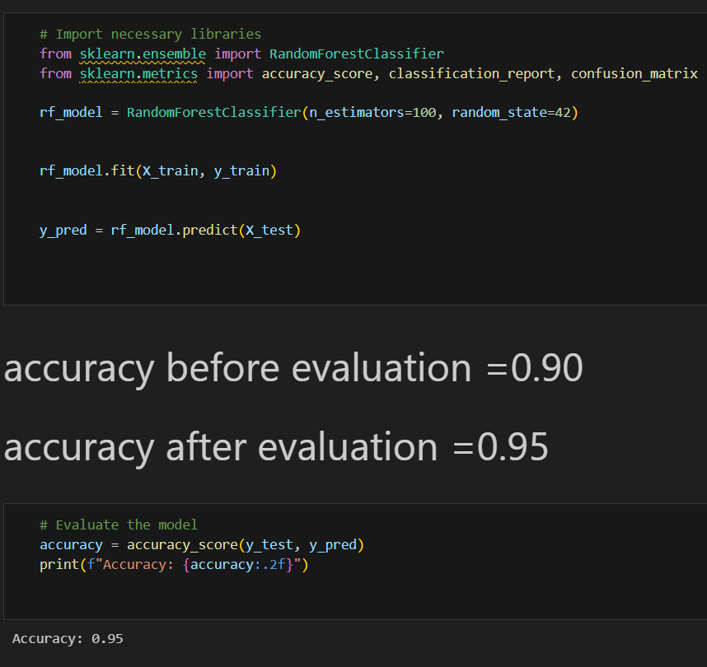

Slide 27
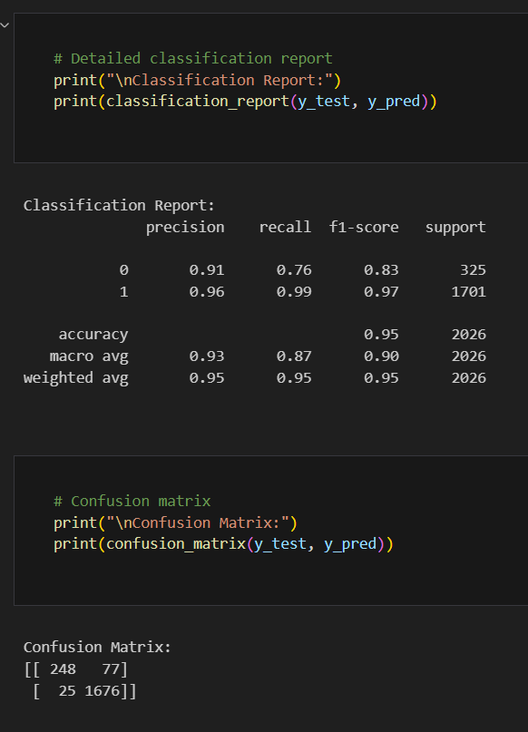

Slide 28
Data visualization
Histogram :between numercal values
Boxplot : between categorical values
Scatter plot : Avg_Open_To_Buy vs. Total_Trans_Amt

Slide 29
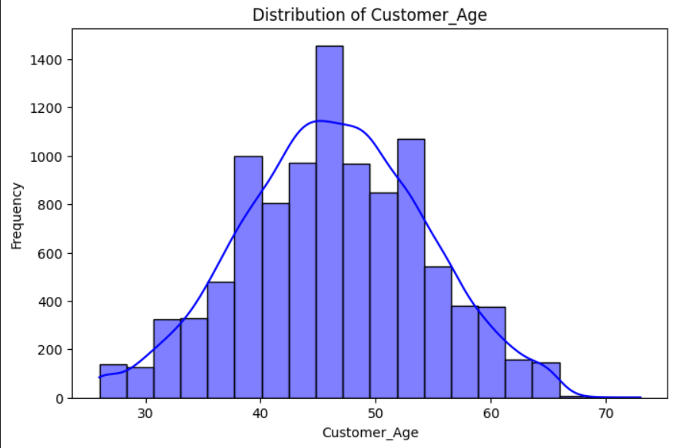
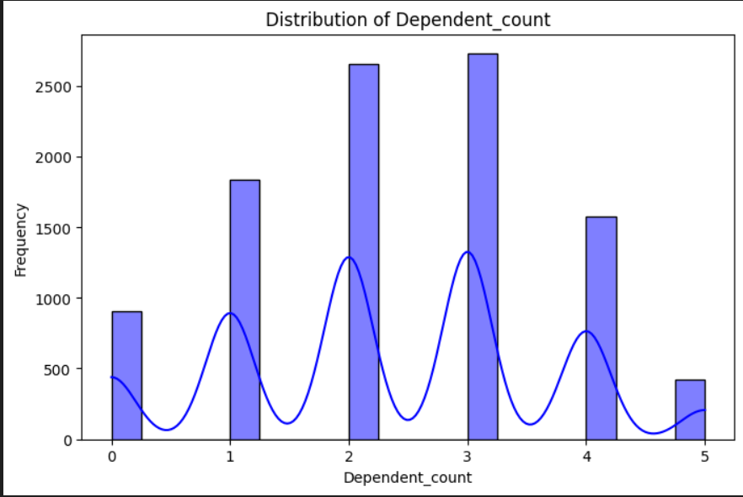
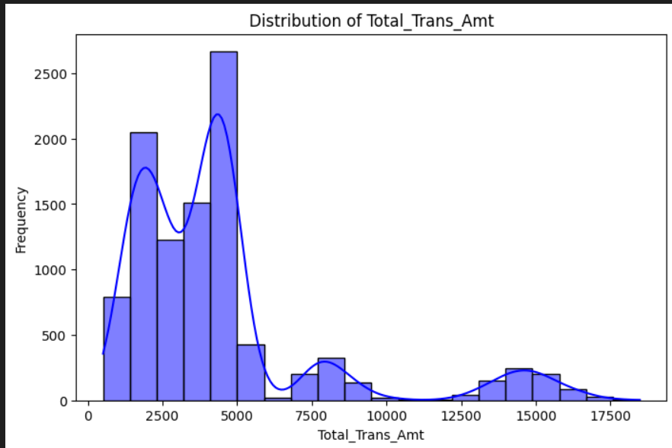
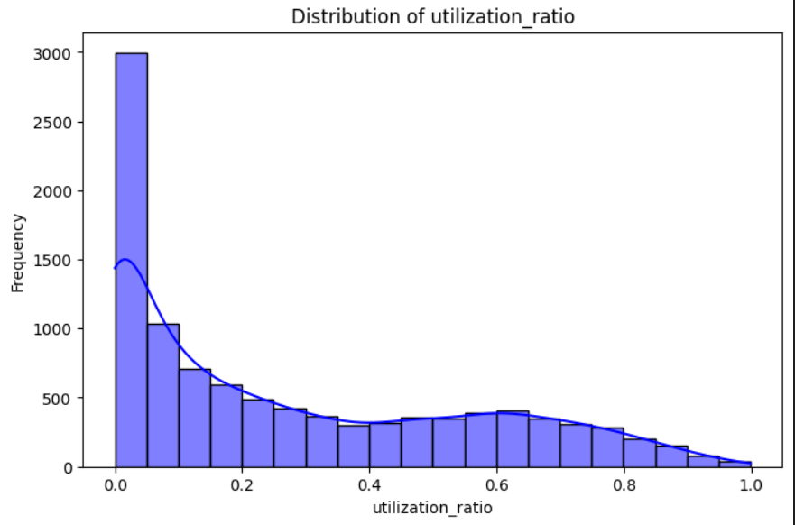

Slide 30
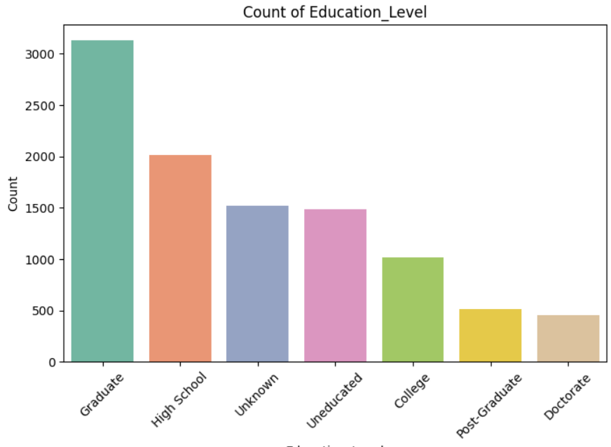
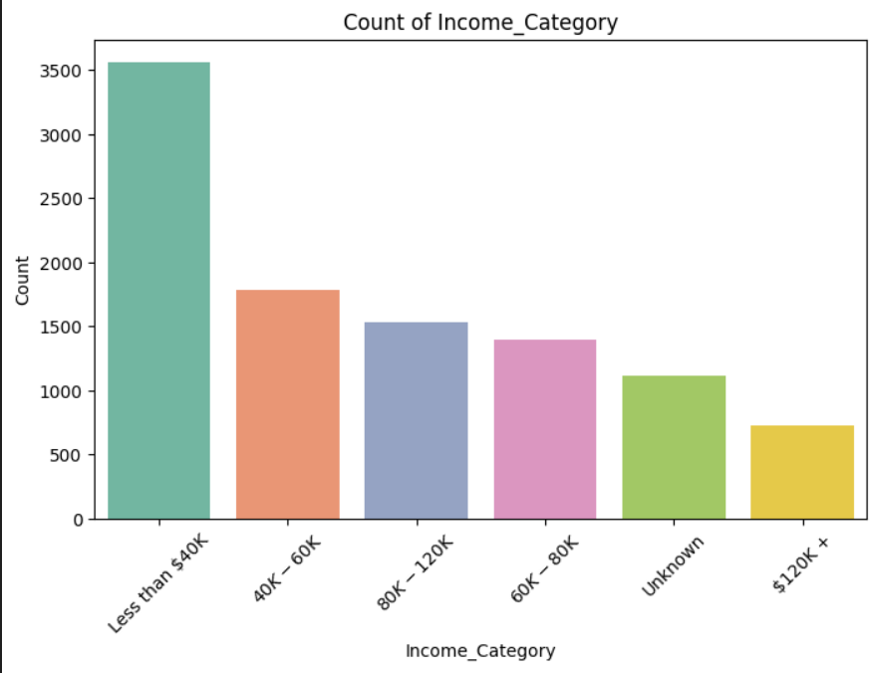
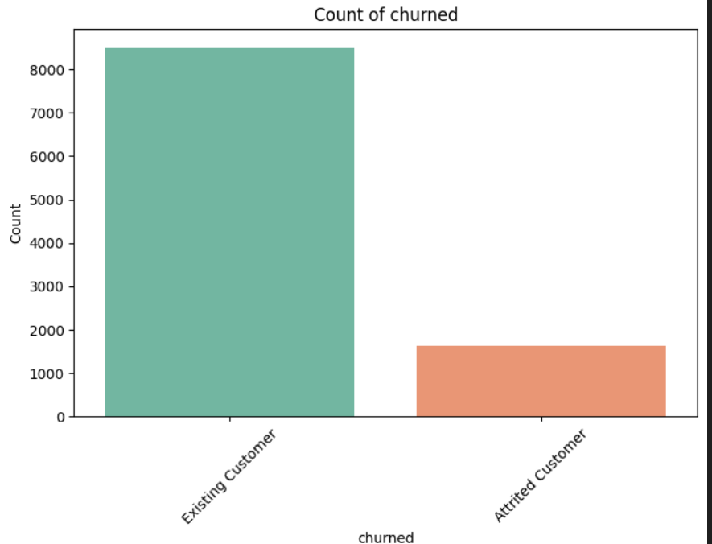

Slide 31
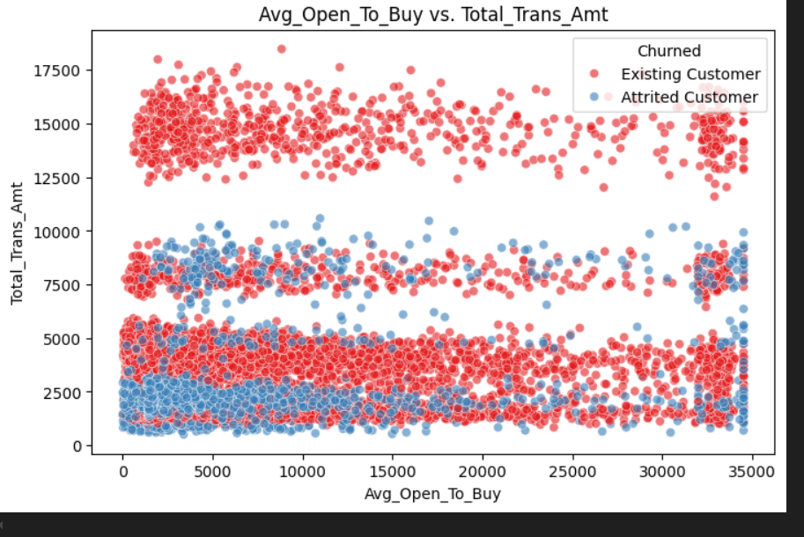

Slide 32

POWER bi

Slide 33
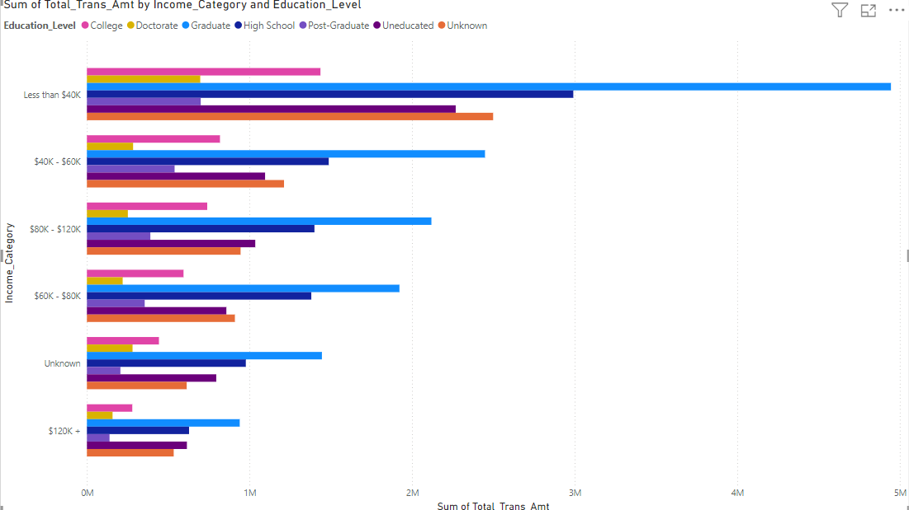
Economic Disparities:
Analyze how transaction amounts differ across income levels and education.
Identify which income groups are economically active or underperforming.
Policy Impact:
Evaluate how education impacts spending within income groups, guiding education-focused economic policies.
Economic Growth Drivers:
Determine which demographic groups contribute the most to economic activity.
Insights You Can Gain

Slide 34
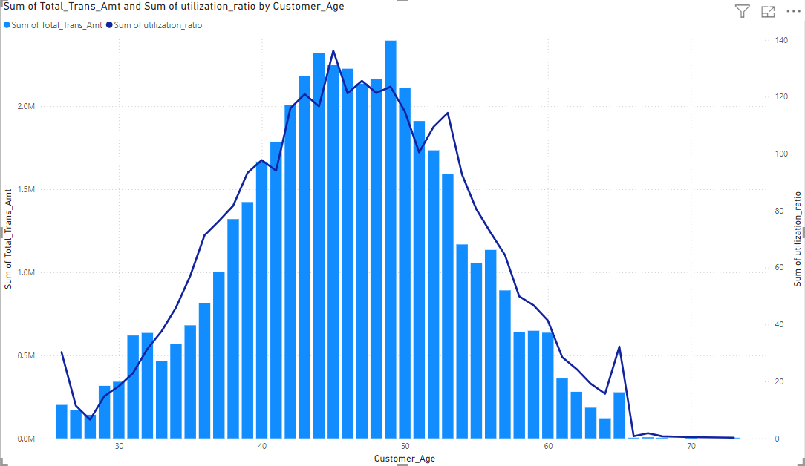
nsights You Can Gain Spending Patterns by Age: See which age groups contribute the most to total transaction amounts and the number of transactions. Credit Utilization Trends: Understand how credit card usage (utilization ratio) increases or decreases as customers age. Economic Behavior Across Age: Identify whether younger customers are spending more but utilizing less credit or if older customers are utilizing credit at higher rates. Resource Allocation: Use the insights to target marketing efforts or financial products at the age groups with higher transaction counts or credit utilization.

Slide 35
Results
Highlight key results:
Best model: [classification bank customers and marketing]
Accuracy: [./.95]
Important features influencing markerting prediction.

Slide 36
Business Recommendations
target at-risk customers with personalized offers to enhance retention and reduce churn.
Enhance customer service for high-value segments to foster loyalty and increase satisfaction.
Monitor transaction activity and utilization ratio to optimize marketing efforts and boost customer engagement.

Slide 37
Challenges and Future Work
Challenges:
Imbalanced dataset.
Limited feature granularity.
Future Work:
Use of advanced models (e.g., machine learing).
real-time develop churn prediction system to improve marketing strategies and customer targeting

Slide 38
Conclusion
Summarize:
: Enables businesses to make proactive, data-driven marketing decisions, focusing on encouraging fixed banking transactions and promoting customer loyalty.
Effectiveness:
The developed system achieves high accuracy and offers valuable insights into withdrawal and deposit patterns, supporting targeted campaigns and enhancing customer retention strategies.

Slide 39
Thank you

